Slide 1
Demo presentation
Matyas Molnar
Week 02

Slide 2
Content
No introduction today
Unexpected problems
Code from the beginning of week
Project example

Slide 3
An unexpected problem: IntelliJ IDEA crash
Click to run a program in a class (call it program A)
It works and looks good, but then..
You try to run another program in another class
And it again runs program A, even though you specified that you wish to run program B
How to solve it?
Close and open again IntelliJ (probably won`t help)
Open a new class and write another program (call it program C, worked once)
Ultimate solution: comment out problematic parts in program A, and run program C

Slide 4
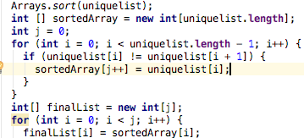
Unique List exercise

Slide 5
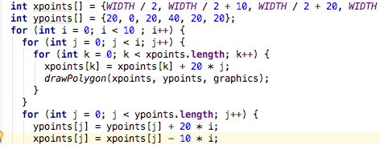
Draw Triangle (project) - how not to do it

Slide 6
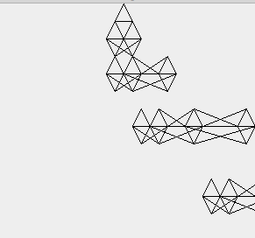

Result:

Slide 7
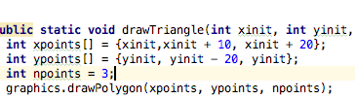
Draw Triangle Project – Start simple: Draw a single triangle

Slide 8

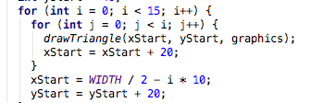
Draw Triangle Project – create loops

Slide 9
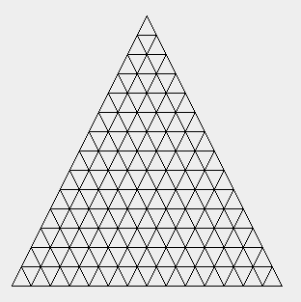

Yeah!!

Slide 10
Thanks for watching!

